Slide 1
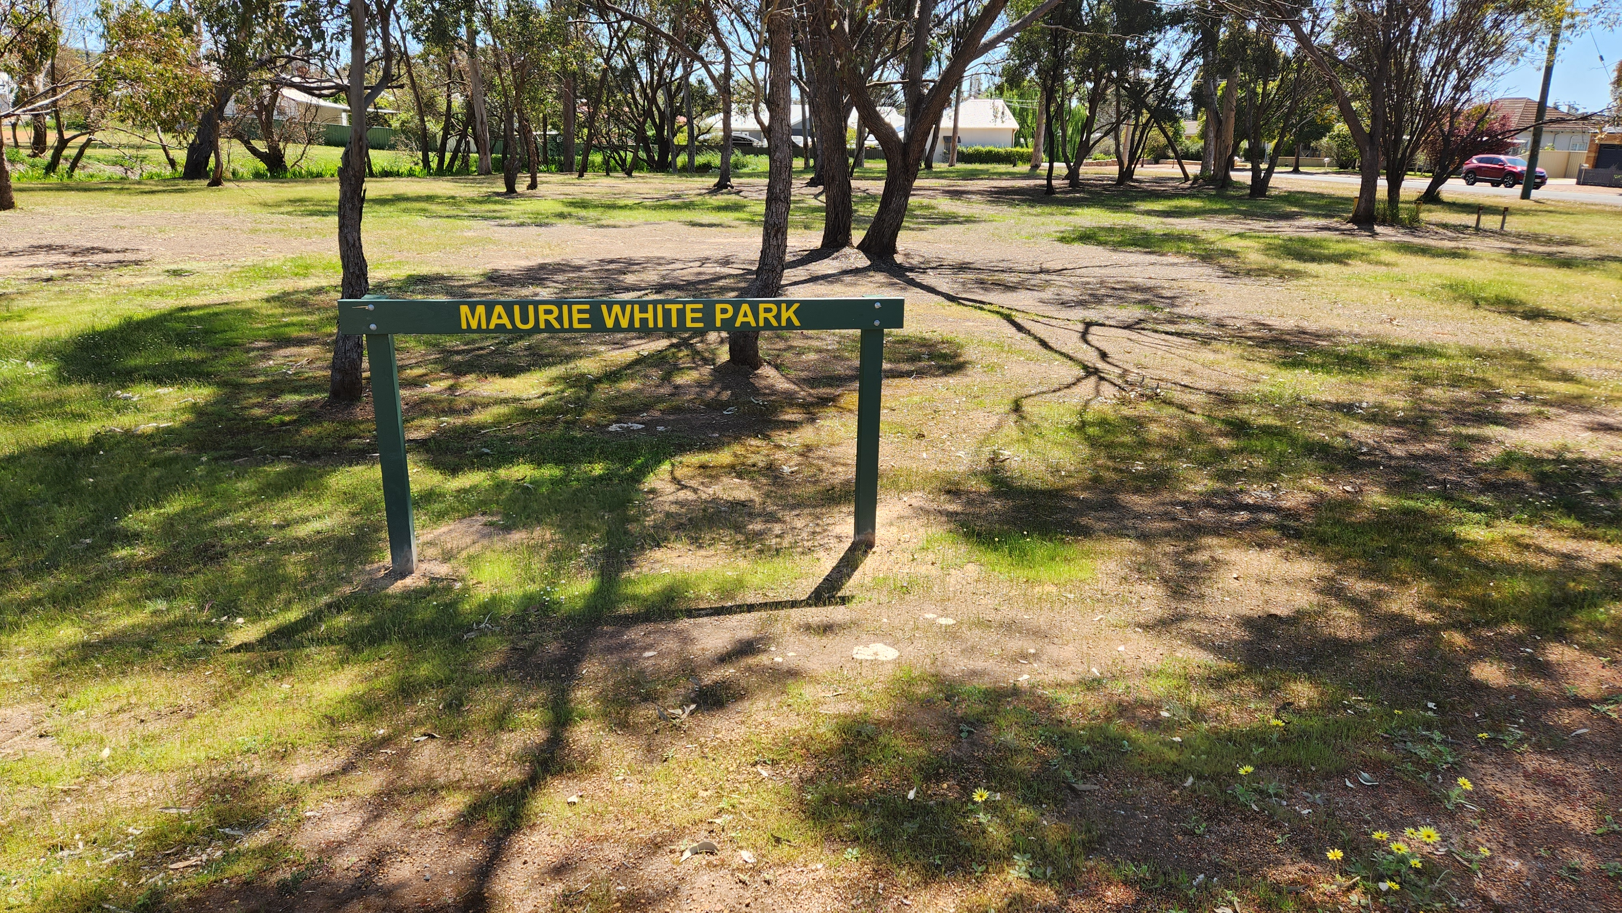
Maurie White Park is located in Pitt Street and is named after Mr Maurie White who was a well regarded, long serving volunteer historian.

